Slide 1
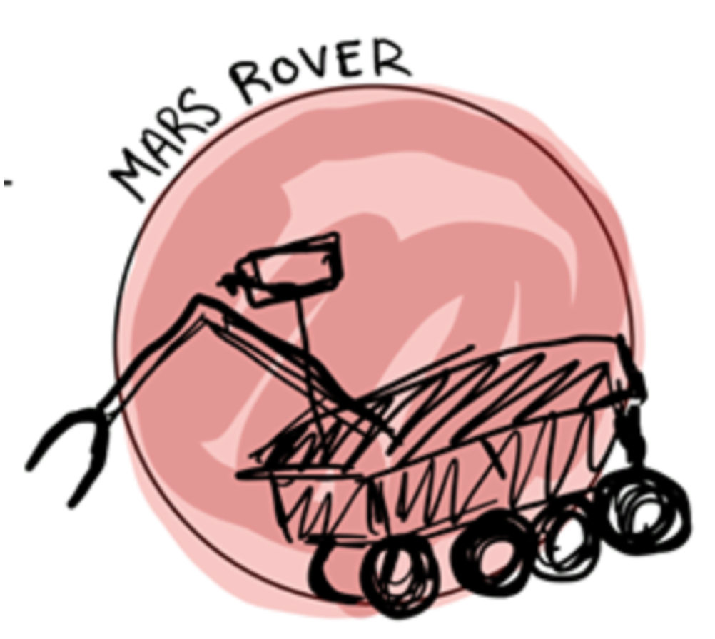
Autonomous Navigation
By Team 28 | ECE Department
Linden Vo, Tommy Lam, Daniel Crawley, Brian He, Kelly Lee

Slide 2
Value Proposition
Who is this for?
University Mars Rover Challenge
Who wants/needs this product?
NASA
Other autonomous driving companies
What is this product?
The Mars Rover is a rover capable of autonomous movement with the use of GPS that can traverse the terrain of Mars or similar and withstand weather and atmosphere conditions using visual navigation and inertial navigation.
So what?
Rover provides opportunities to service and explore unknown terrain.
Notes:
Note that sometimes you need more than one value proposition. For example if the beneficiary does not pay you, then you need one value proposition for your beneficiary and one for your paying customer.
https://drive.google.com/file/d/1kcVCmDnck-nL4R97RcC-8TRkUEa3AK11/view?usp=sharing

Slide 3
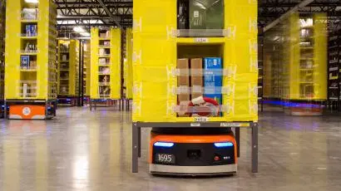
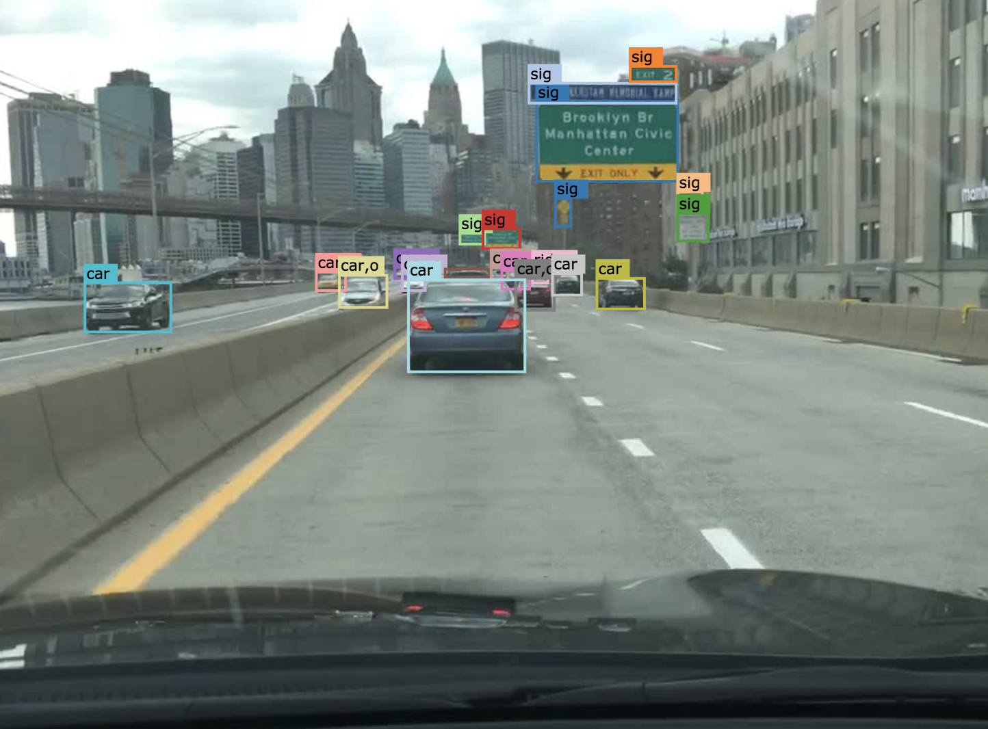
Value Proposition
Competition?
Amazon Robotics
Berkeley DeepDrive
Other Mars Rover Teams
https://medium.com/the-rivers-school/charlie-leslie-18-amazon-robotics-internship-journal-part-ii-763c3a95141e
https://bdd-data.berkeley.edu/
Notes:
Note that sometimes you need more than one value proposition. For example if the beneficiary does not pay you, then you need one value proposition for your beneficiary and one for your paying customer.
https://drive.google.com/file/d/1kcVCmDnck-nL4R97RcC-8TRkUEa3AK11/view?usp=sharing

Slide 4
Mars Rover Autonomous Traversal
Goal
Autonomously navigate over rugged terrain similar to Mars using LIDAR, inertial sensors, or cameras from point A to point B.
Societal Impact
Safely conduct search and rescue operations
Improving self driving vehicles
What is special about your project?
Handle extreme conditions: temperature + rainy weather
Smart and durable: can navigate rough terrain and avoid obstacles
Object recognition: locate AR checkpoint gates and drive towards them
Technology Solution
Computer vision algorithms for detecting AR tag
Control algorithms - PID controller to navigate to specified point
LIDAR or IMU implementation for detecting obstacles - 3D pose estimation

Slide 5
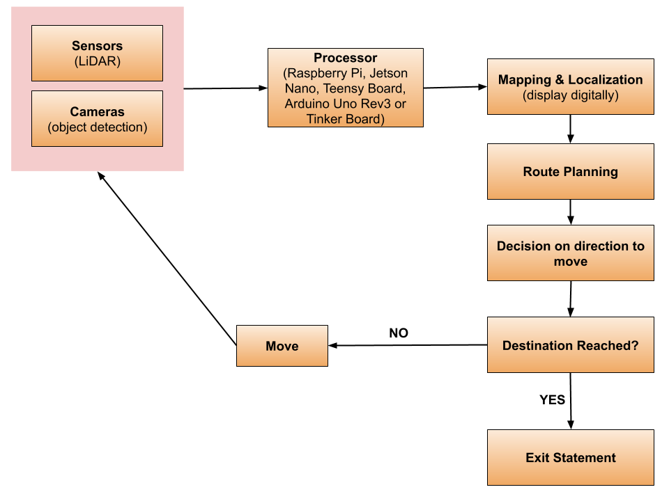
System Overview

Slide 6

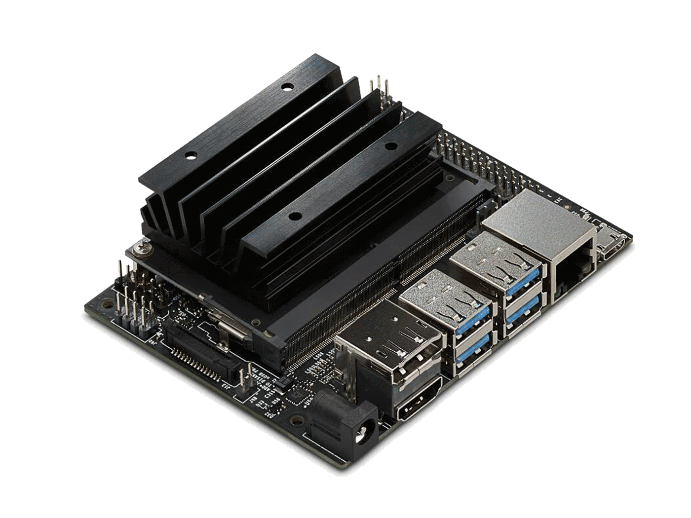


Software/Hardware
NVIDIA Jetson Nano
TensorFlow

Slide 7

Thank you!
http://blingee.com/blingee/view/114681511-Wall-E-Thank-You

